Slide 1
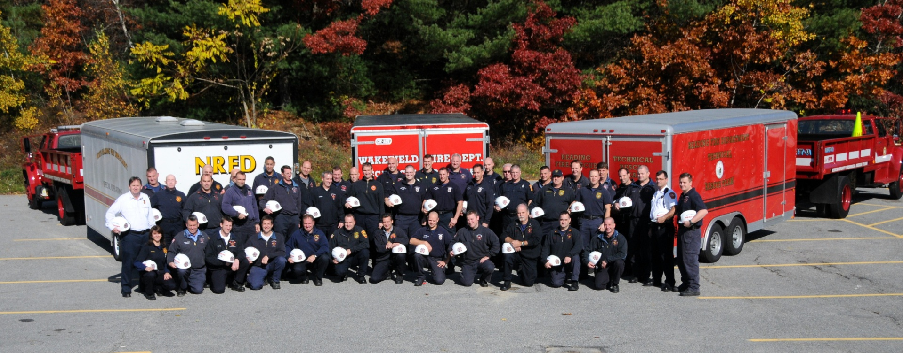

Northeast Massachusetts Technical Rescue Team

Slide 2
Northeast Massachusetts Technical Rescue Team
Why do we need it?
Where did it come from?

Slide 3
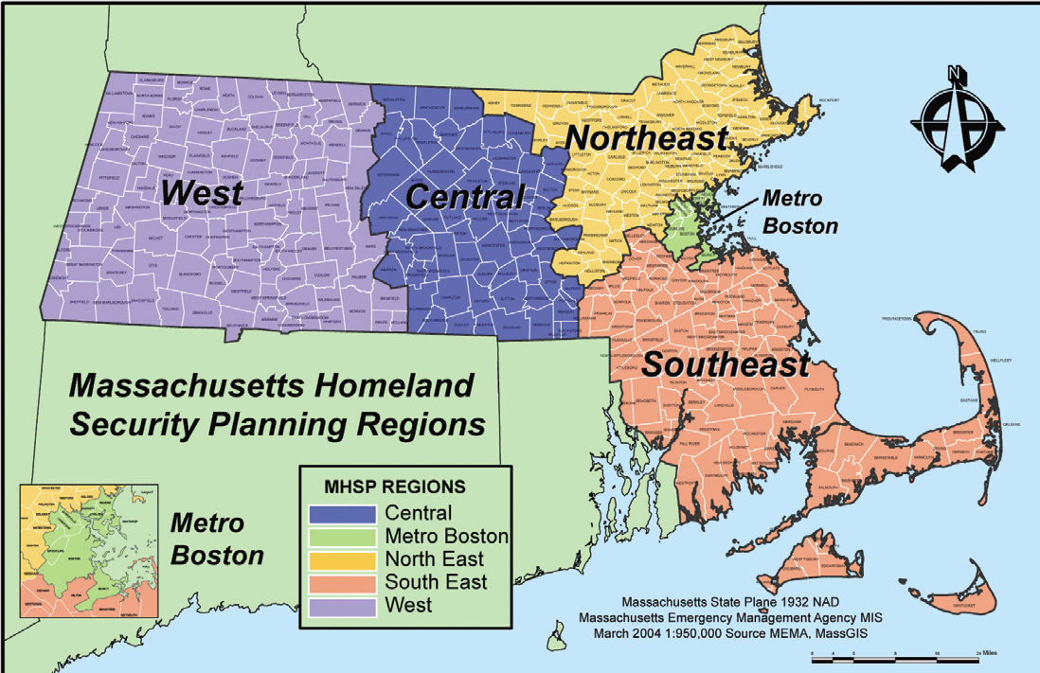
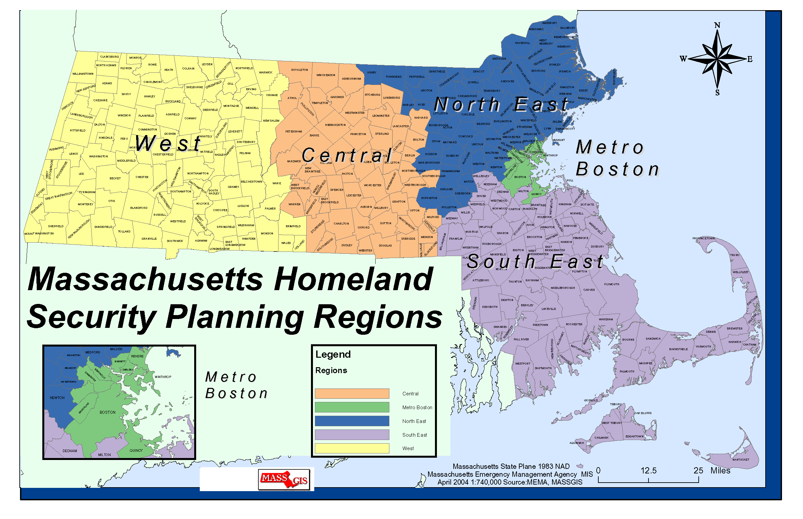

Slide 5
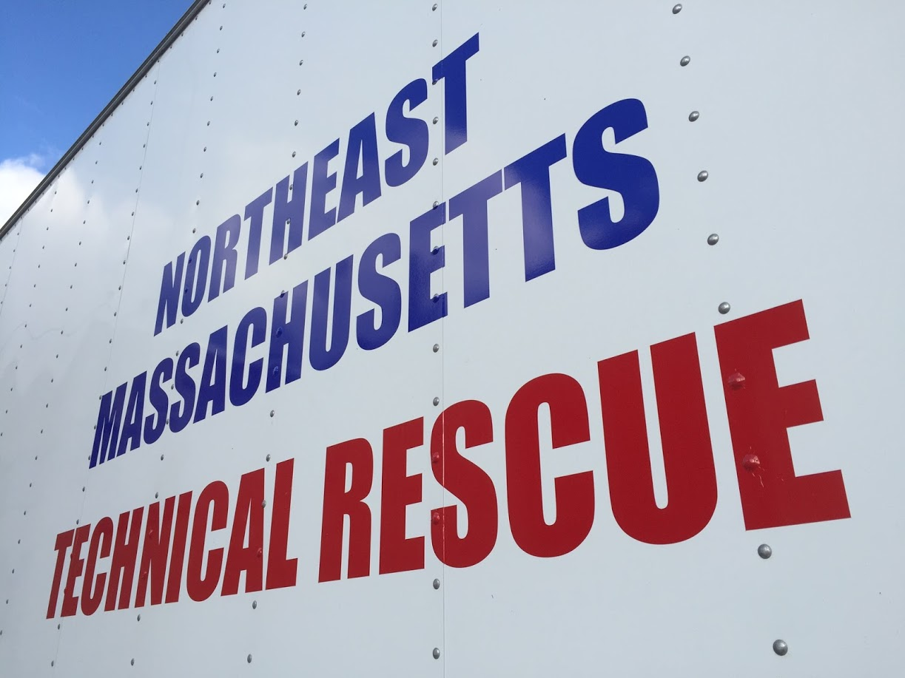
Who are we?
Team made of firefighters.
Currently there are 52 members
All from NERAC area Departments

Slide 6
Where are we from?
27 Fire Dept.
Amesbury
Andover
Bedford
Beverly
Chelmsford
Danvers
Gloucester
Hamilton
Haverhill
Ipswich
Lawrence
Lynn
Manchester
Marblehead
Melrose
Methuen
Middleton
Newburyport
North Andover
North Reading
Peabody
Reading
Saugus
Tewksbury
Wakefield
Wilmington
Winchester

Slide 7
What do we have for Equipment?
Each Truck / Trailer is equipped to handle
Rope, Confined Space, and Trench Rescues
Squad 2 Truck has SCT Equipment
Where did the trucks (and trailers) come from?
Box Truck- DCR surplus
Rescue Truck – Burlington Fire
Trucks – military surplus
Trailers – existing trailers within communities

Slide 8
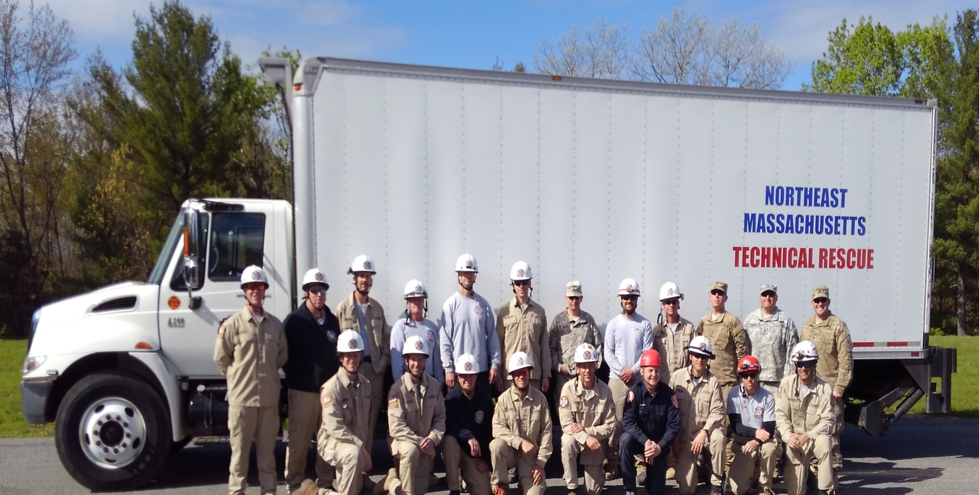
Vehicles

Slide 9
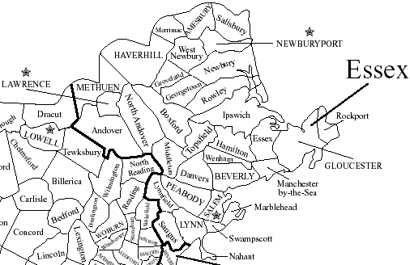
Where are the kept?
Squad 1 – Ipswich
Squad 2Truck – North Reading
Squad 3 Truck – Peabody
3
2
1

Slide 10
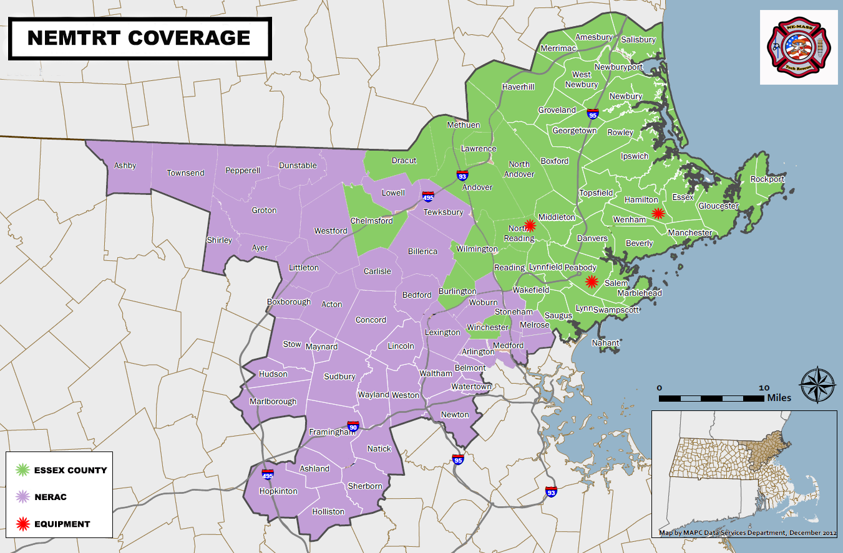
Why are they kept there?
Lanes of travel.
Population.
Community willing to host.

Slide 11
Squad 1
Amesbury
Georgetown
Haverhill
Lawrence
Merrimac
Methuen
Newburyport
Rowley
Salisbury
West Newbury
Newbury

Slide 12
Squad 2
Andover
Boxford
Chelmsford
Lynn
Lynnfield
Middleton
Nahant
North Andover
North Reading
Reading
Saugus
Swampscott
Wakefield

Slide 13
Squad 3
Beverly
Danvers
Essex
Gloucester
Hamilton
Ipswich
Manchester
Marblehead
Melrose
Peabody
Rockport
Salem
Topsfield
Wenham

Slide 14
NORTHEAST MASSACHUSETTS / NERAC COMMUNITIES
District 1 | Primary | Secondary | District 2 | Primary | Secondary | District 3 | Primary | Secondary
Amesbury | 1 | 3 | Andover | 2 | 1 | Beverly | 3 | 2
Georgetown | 1 | 3 | Boxford | 2 | 1 | Danvers | 3 | 2
Groveland | 1 | 3 | Lynn | 2 | 3 | Essex | 3 | 1
Haverhill | 1 | 2 | Lynnfield | 2 | 3 | Gloucester | 3 | 2
Lawrence | 1 | 2 | Middleton | 2 | 3 | Hamilton | 3 | 1
Merrimac | 1 | 2 | Nahant | 2 | 3 | Ipswich | 3 | 1
Methuen | 1 | 2 | North Andover | 2 | 1 | Manchester | 3 | 2
Newbury | 1 | 3 | North Reading | 2 | 1 | Marblehead | 3 | 2
Newburyport | 1 | 3 | Reading | 2 | 3 | Peabody | 3 | 2
Rowley | 1 | 3 | Saugus | 2 | 3 | Rockport | 3 | 2
Salisbury | 1 | 3 | Swampscott | 2 | 3 | Salem | 3 | 2
West Newbury | 1 | 3 | Wakefield | 2 | 3 | Topsfield | 3 | 1
 |  |  |  |  |  | Wenham | 3 | 1
OTHER NERAC COMMUNITIES
Community | Primary | Secondary | Community | Primary | Secondary | Community | Primary | Secondary
Acton | 1 | 2 | Groton | 1 | 2 | Sherborn | 2 | 1
Arlington | 2 | 3 | Holliston | 1 | 2 | Shirley | 1 | 2
Ashby | 1 | 2 | Hopkington | 1 | 2 | Stoneham | 2 | 3
Ashland | 1 | 2 | Hudson | 1 | 2 | Stow | 1 | 2
Ayer | 1 | 2 | Lexington | 2 | 3 | Sudbury | 2 | 1
Bedford | 2 | 3 | Lincoln | 2 | 3 | Tewksbury | 2 | 1
Belmont | 2 | 3 | Littleton | 1 | 2 | Townsend | 1 | 2
Billerica | 2 | 1 | Lowell | 1 | 2 | Tyngsborough | 1 | 2
Boxborough | 1 | 2 | Malden | 3 | 2 | Waltham | 2 | 3
Burlington | 2 | 3 | Marlborough | 1 | 2 | Watertown | 2 | 3
Carlisle | 1 | 2 | Maynard | 1 | 2 | Wayland | 2 | 3
Chelmsford | 1 | 2 | Medford | 2 | 3 | Westford | 1 | 2
Concord | 2 | 3 | Melrose | 3 | 2 | Weston | 2 | 3
Dracut | 1 | 2 | Natick | 2 | 1 | Wilmington | 2 | 1
Dunstable | 1 | 2 | Newton | 2 | 3 | Winchester | 2 | 3
Framingham | 2 | 1 | Pepperell | 1 | 2 | Woburn | 2 | 3

Slide 15
Where do we fit into your incident?
We are a resource for your Department.
We work within your Incident Command System
Require your Company Officers to identify the need and Make the Call.

Slide 16

Your Department
You maintain control!

Slide 17
How Are We Activated?
Contact either Fire District control points
District 5 Control
(978) 922-2424
District 15 Control
(978) 475-1281

Slide 18
Our Response
Two Squads are dispatched
Rope & Confined Space
Three Squads are dispatched
Trench & Structural Collapse
Up to 15 members per Squad
We will check response numbers and request additional team members if needed.
Each Squad come with Equipment Vehicle
Logistics Trailer if needed at the Incident

Slide 19
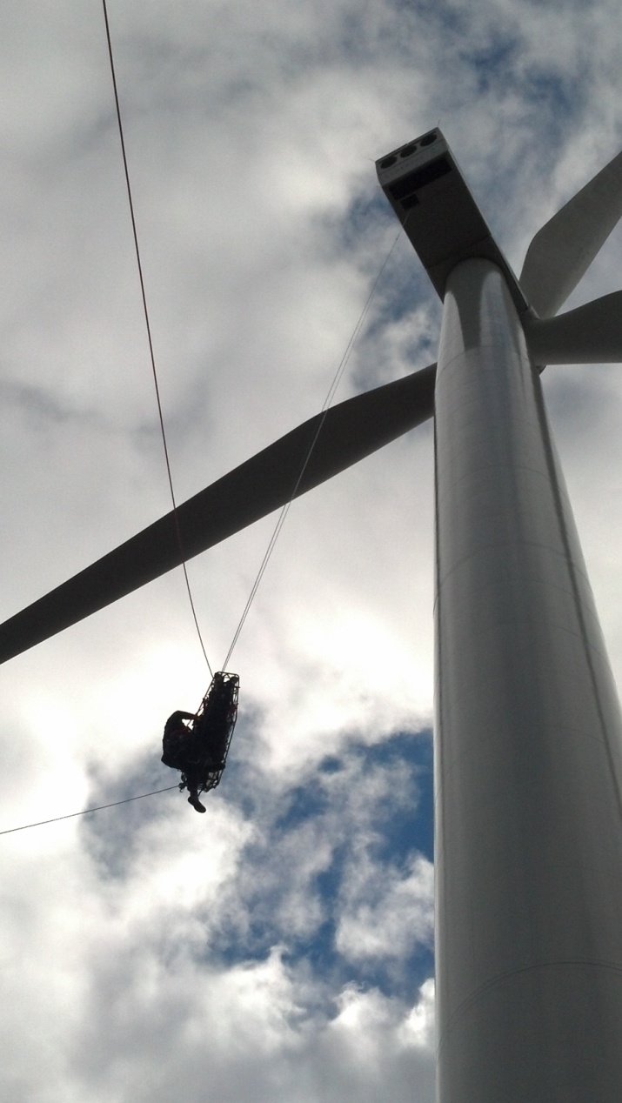
What are we trained for?
Rope Rescue

Slide 20
2 types of rope rescue incidents
High-angle rope rescue
Low-angle rope rescue

Slide 21
High-angle Rope Rescue
Tall buildings, towers, >45 degree embankments / cliffs
May also be confined space operation utilizing high-angle rope rescue skills

Slide 22
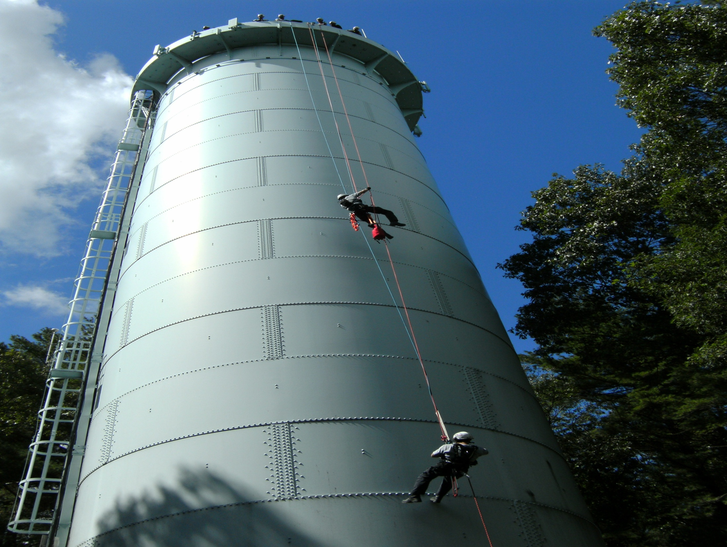

Slide 23
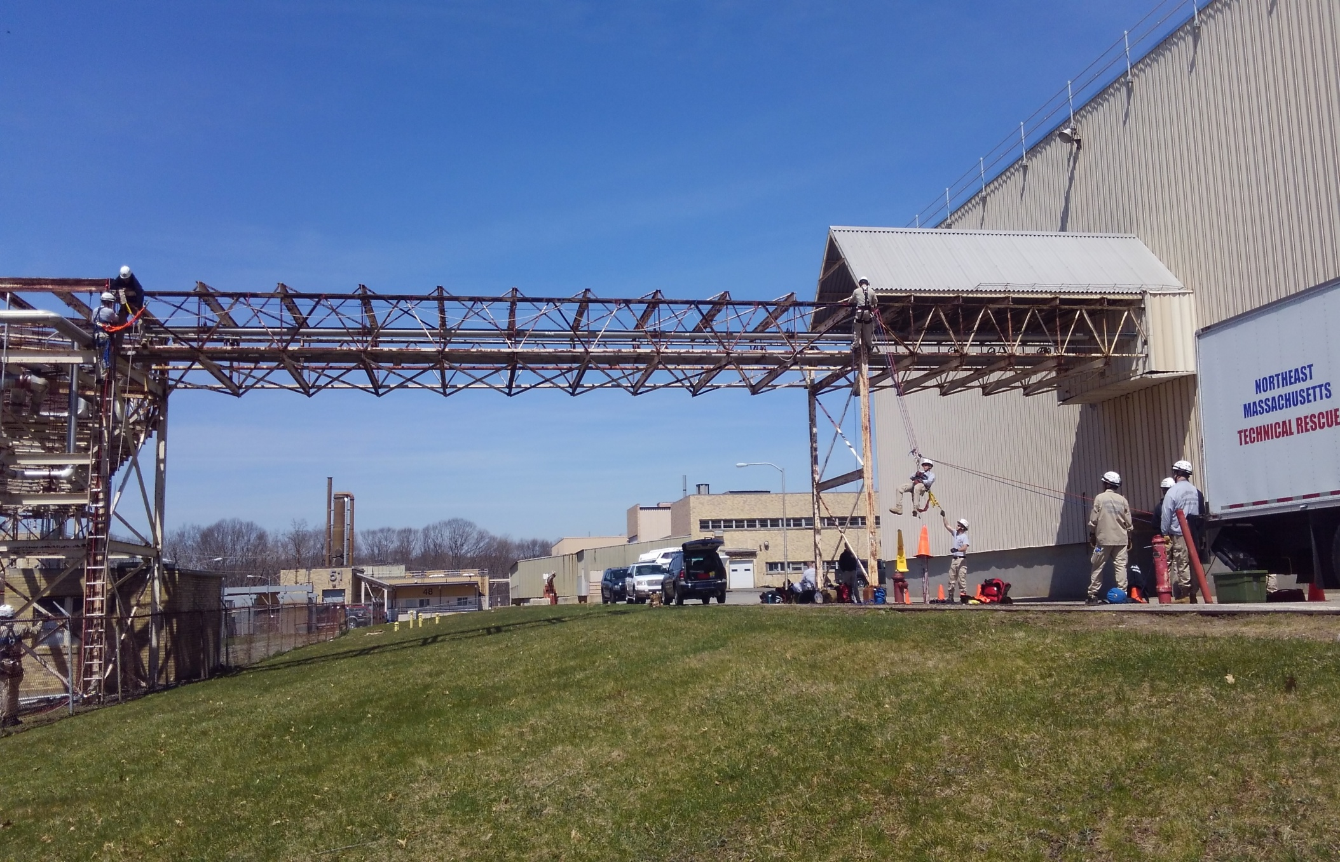

Slide 24
Low-angle Rope Rescue
Incidents where slope of ground is 45 degrees or less
Ice covered surfaces (highway embankments)
Loose ground material covered slope

Slide 25
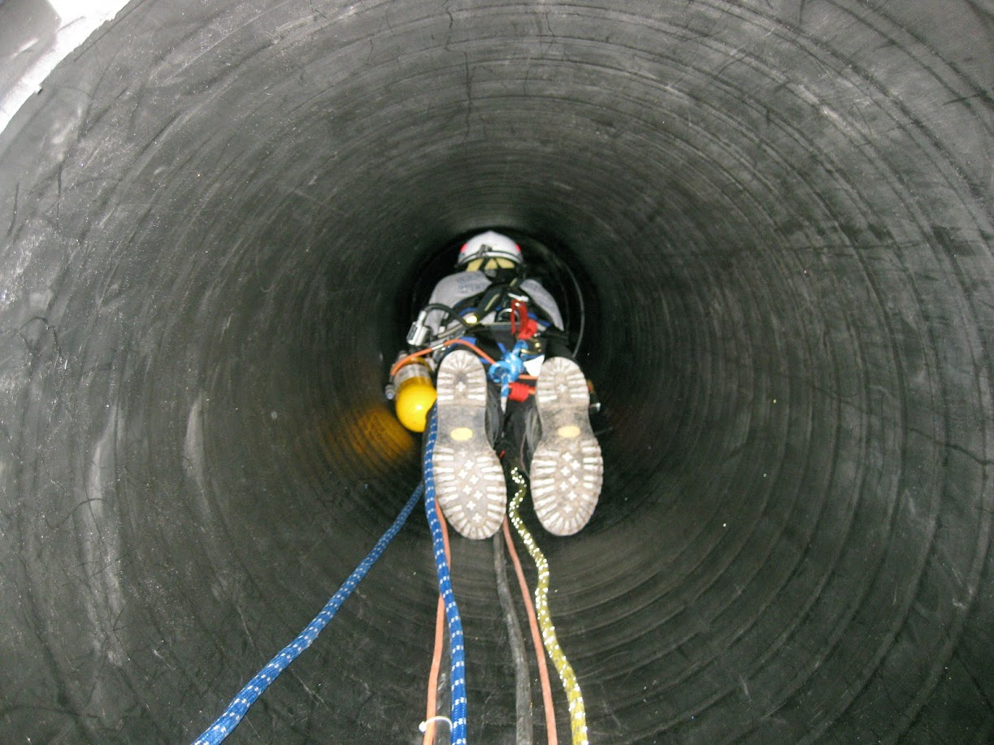
What are we trained for?
Confined Space

Slide 26
OSHA 29 CFR 1910.146
Confined space regulations

Slide 27
“Rescue Service”
“the personnel designated to rescue employees from permit spaces.”
Who does the private sector list???
Usually, the Fire Department!

Slide 28
FACT
60% of all Confined Space Deaths are from Untrained Rescuers

Slide 29
Safety Considerations
Hazardous Atmosphere is # 1
Use caution when approaching entry point
Ask, what caused problem?
Is SCBA needed?

Slide 30
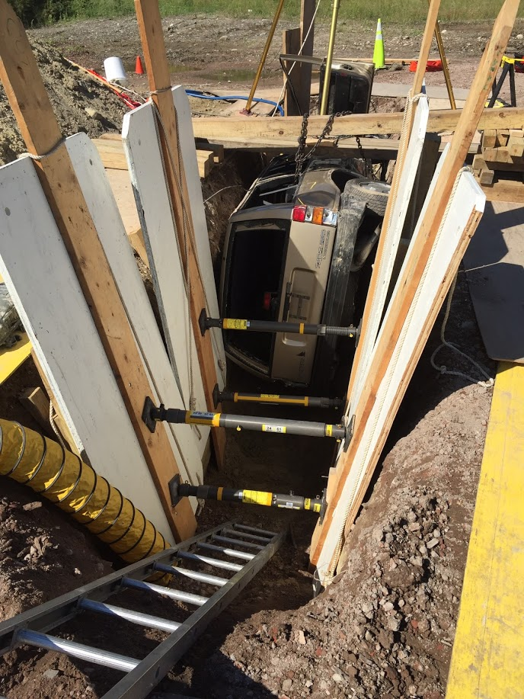
What are we trained for?
Trench Rescue

Slide 31
Ipswich, MA 11-19-13
Contractor installing new sewer line
Trench 50’L x 6.5’W x 10’D No Protection
Trench collapsed victim buried chest high
IFD & IPD started dig, then called ECTRT
3 Hours to shore and dig 5’ soil off victim

Slide 32
What makes a Trench?
Deeper then it is wide
Normally not more then 15 feet wide at the bottom
OSHA requires a depth greater then 4 feet be protected

Slide 33
Safety at the Site
Position the apparatus no less than 250 feet from trench.
Always approach the trench from the ends.
Shut down all machinery in the hot zone.
Stop all traffic within 500 feet of trench.
Secure a responsible person.

Slide 34
What can you do?
If trench is unsecured stop all rescue efforts.
Especially if machinery is involved
Place ground pad at end and get a ladder in the hole
Perform a non-entry rescue if possible

Slide 35
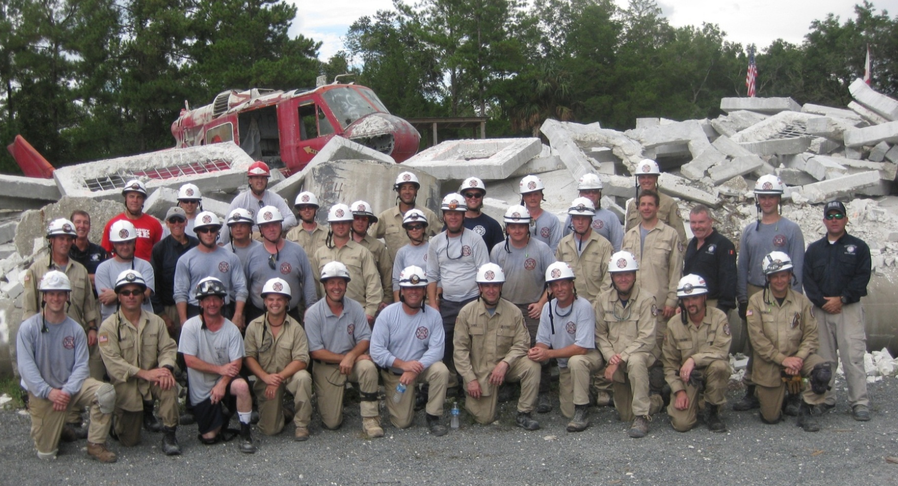
What are we trained for?
Structural Collapse Rescue

Slide 36
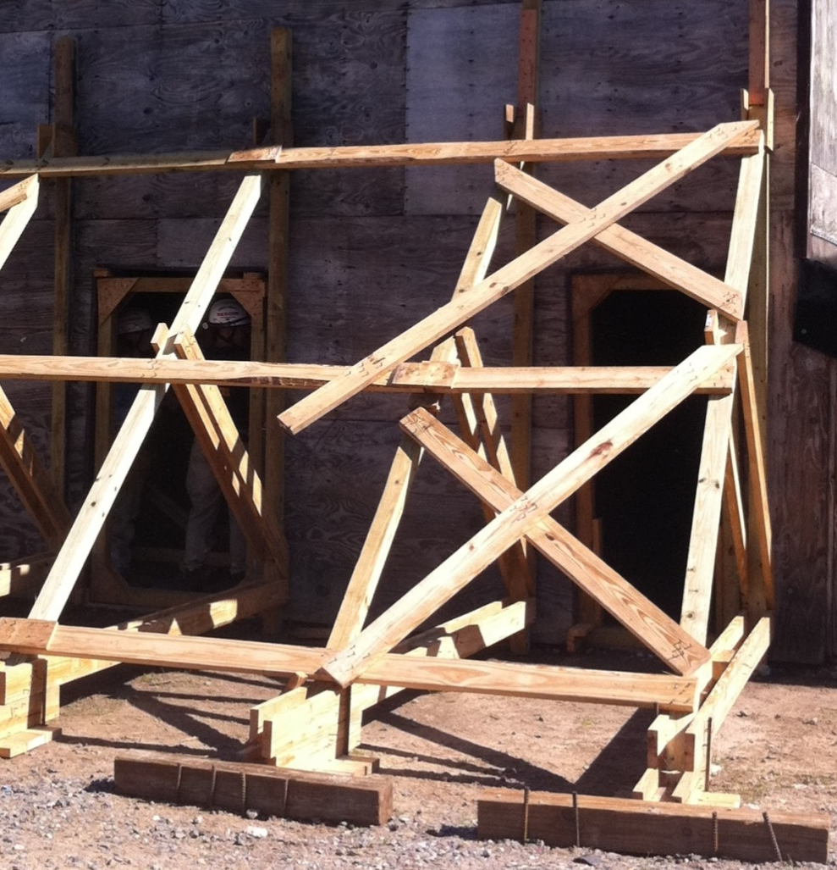
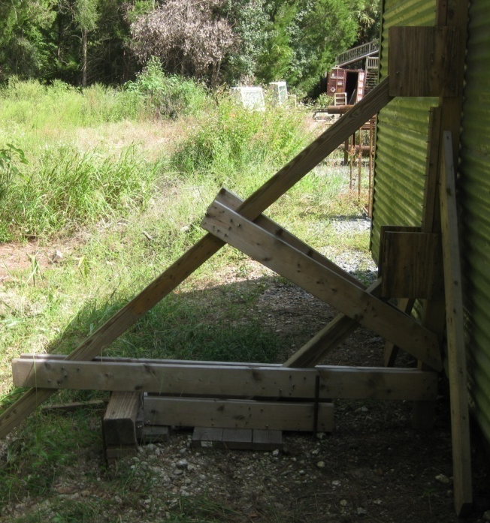
Structural Shoring
Outside

Slide 37
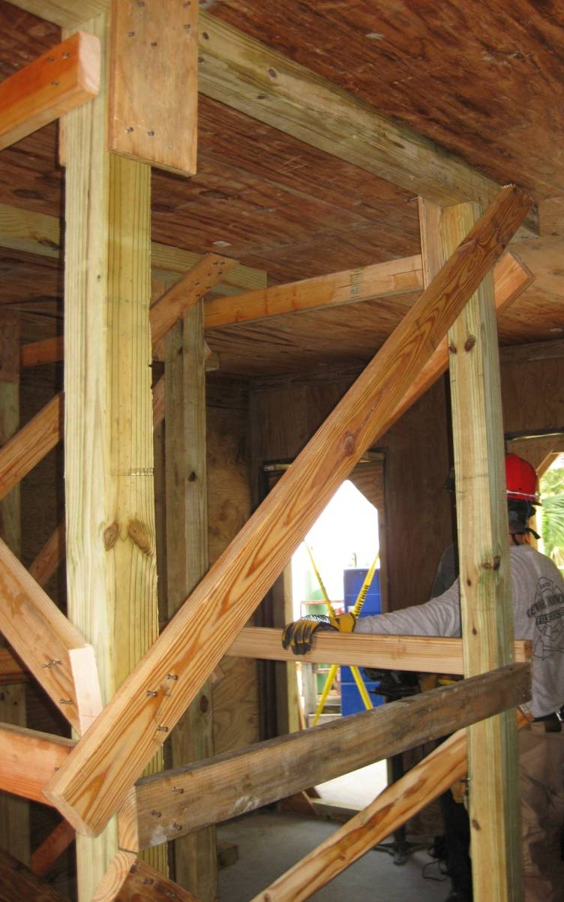
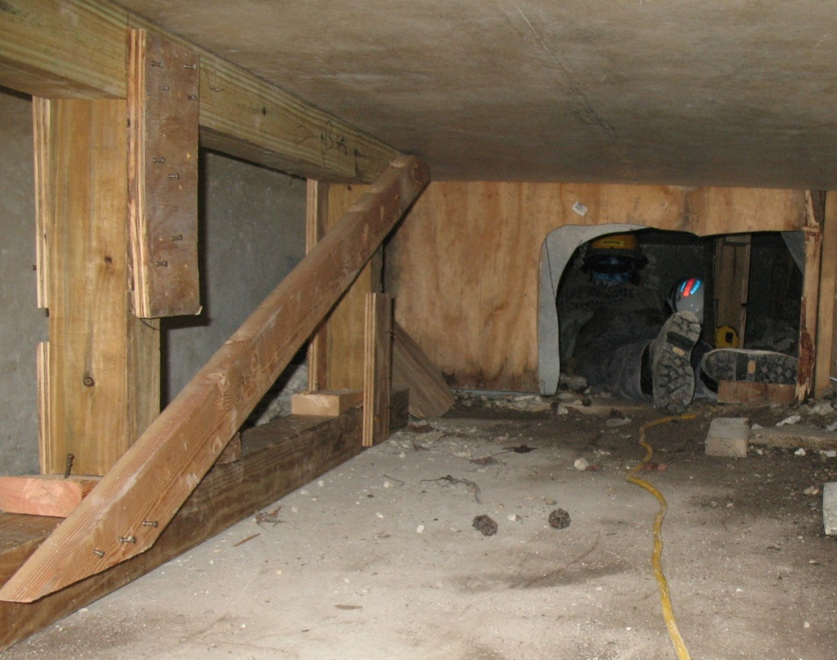
Structural Shoring
Inside

Slide 38
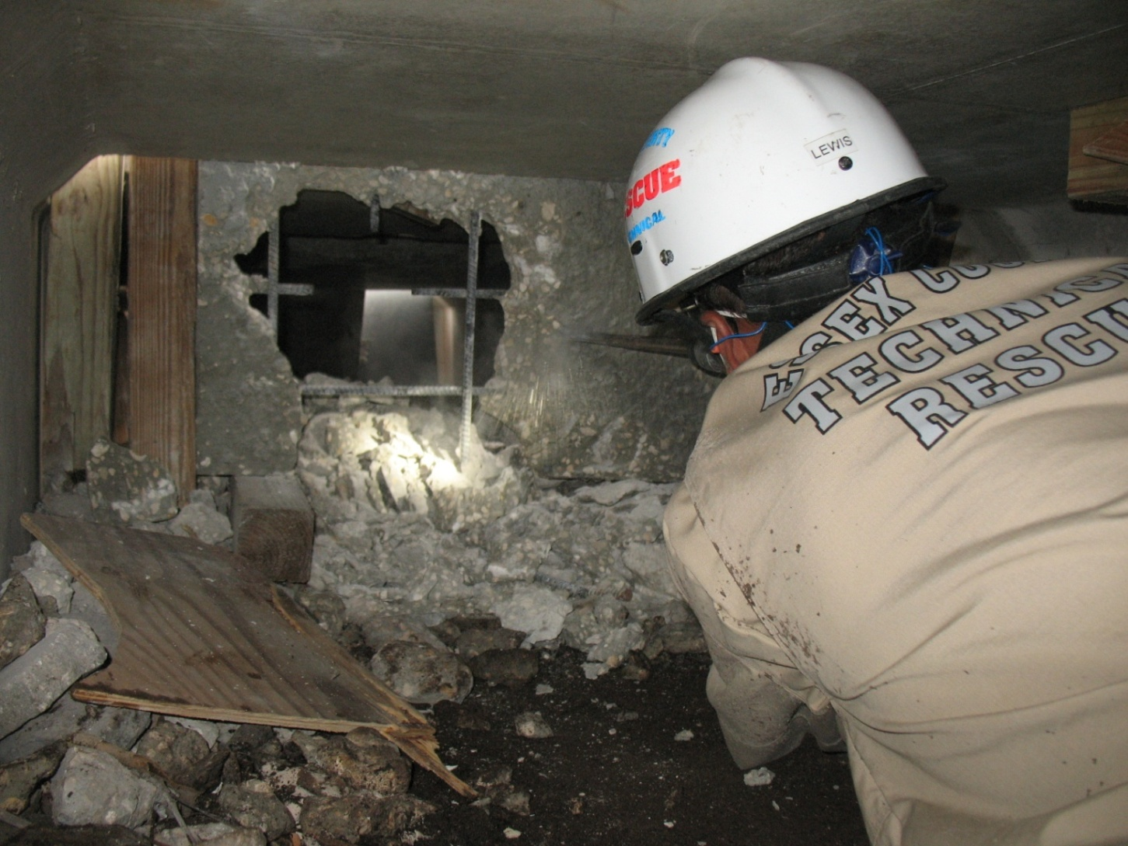
Breaching

Slide 39
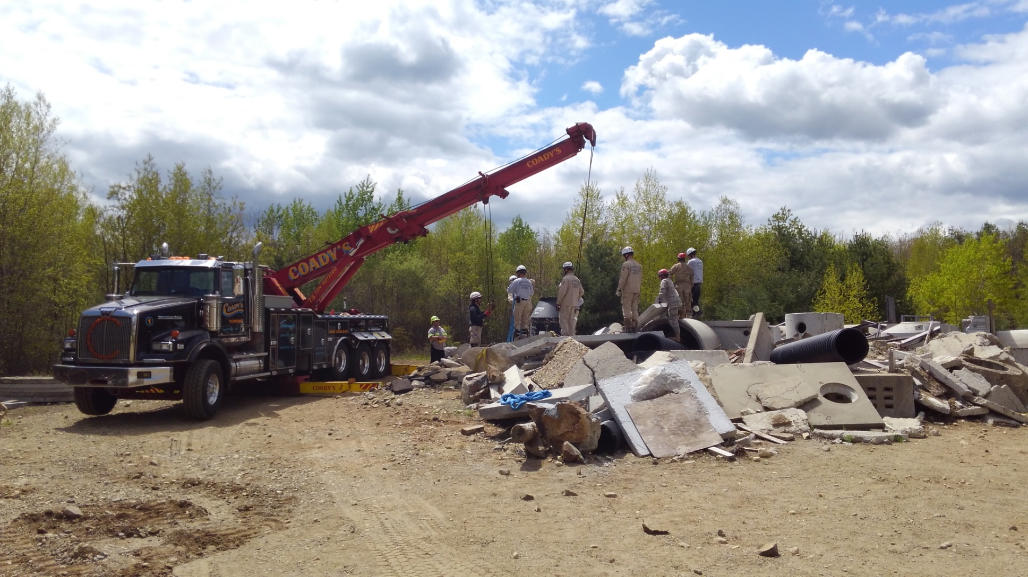
Lifting Operations

Slide 40
What to do prior to Teams Arrival
Gather information
How many victims?
Are they visible? Condition?
Last seen? Where?
How long since incident?
Why is help needed?
i.e. – high angle, confined space, collapse
Hazards?
Secure a witness/ Responsible person

Slide 41
What can we provide
Specially Trained Firefighters and Paramedics, Manpower
Specialized equipment necessary to safely and effective conduct a rescue
Risk management resource
Liability management resource

Slide 42
Wide Area Search
Areas of a disaster
Missing persons

Slide 43
Questions?

